Slide 1



CARBON CAPTURE
WEEK 1
Different Types of Carbon Capture Technology and processes.

Slide 2

LECTURE 4

Slide 3

TOPIC OUTLINE
Storage Activity & Example
Transport Activity
Porosity Activity
Carbon compression Activity
Ocean Acidification Activity

Slide 4
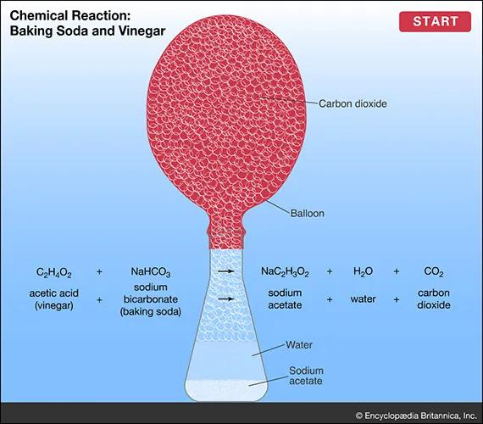
CARBON STORAGE: ACTIVITY
When vinegar and bicarbonate of soda mix, a rapid chemical reaction occurs, producing carbon dioxide (CO₂). This reaction illustrates a fundamental concept in chemistry. Similarly, in power stations using coal or gas, burning produces CO₂. The gas inflates a balloon in the experiment, demonstrating CO₂ capture. This principle underlies Carbon Capture and Storage (CCS), where CO₂ is trapped and stored underground to mitigate climate change. Geosequestration involves storing CO₂ in deep underground reservoirs with specific rock formations that prevent leaks. Before storage, CO₂ must be separated from other gases and liquefied, a process requiring significant energy. This liquid CO₂ is then transported via pipes to the reservoir.

Slide 5
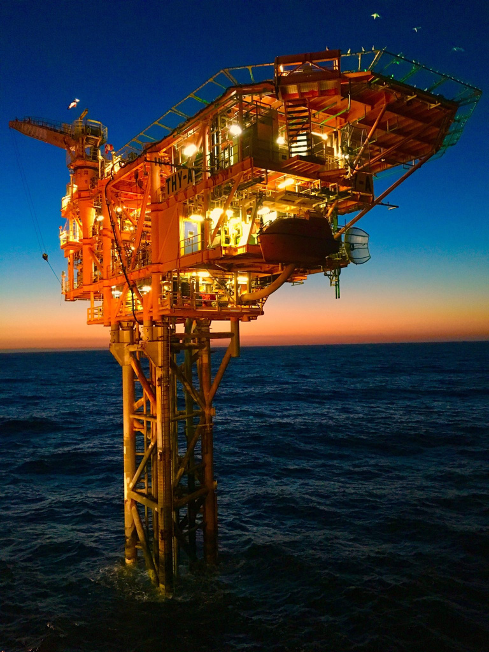
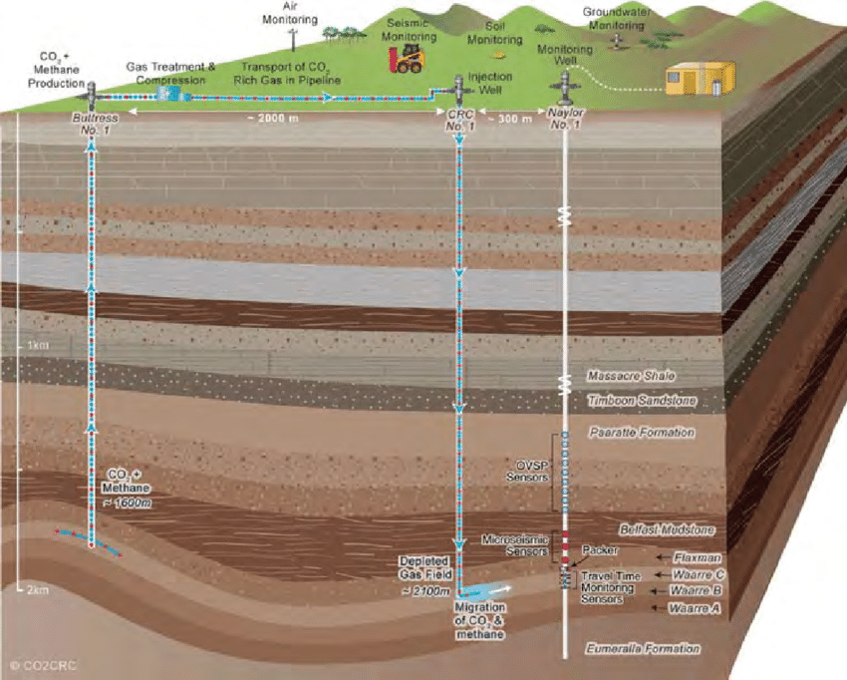
AUSTRALIAN SCIENTISTS HAVE SUCCESSFULLY INJECTED 65,000 TONNES OF CO₂ INTO THE OTWAY BASIN, ENSURING NO LEAKS OCCUR. SUCH PROJECTS HIGHLIGHT THE POTENTIAL OF CCS IN REDUCING GREENHOUSE GAS EMISSIONS FROM POWER STATIONS.

Slide 6

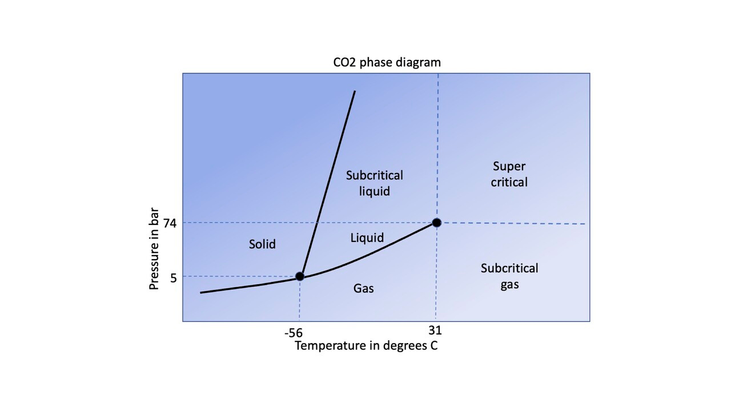
TRANSPORT ACTIVITY
When using a pump, we increase the air pressure by compressing it, causing gases and liquids to move from high to low-pressure areas, which inflates the balloon. This principle is applied in carbon capture and storage (CCS), where CO₂ is transported from power stations to underground reservoirs. In CCS, CO₂ is subjected to extremely high pressures, over 73 times atmospheric pressure, compressing it until it becomes a liquid. At normal pressure, CO₂ molecules have significant space between them, but as pressure increases, this space reduces, turning CO₂ into a 'supercritical liquid,' which exhibits properties of both gas and liquid, facilitating efficient storage.

Slide 7
CCS : TRANSPORT PHASE
In carbon capture and storage (CCS), compressing CO₂ to the high pressures necessary for transport and storage requires significant energy, which can increase overall CO₂ emissions. It is crucial to ensure that the energy used in the CCS process does not exceed the emissions reduced. Additionally, maintaining the integrity of the system under high pressures is critical, as any leaks in the pipes or the storage reservoir could negate the benefits of CCS. Just as higher water pressure in a garden hose increases leakage from small holes, higher pressure in CCS systems increases the risk of CO₂ escaping. Therefore, rigorous measures are necessary to prevent leaks and ensure the effectiveness of CCS in reducing overall CO₂ emissions.

Slide 8
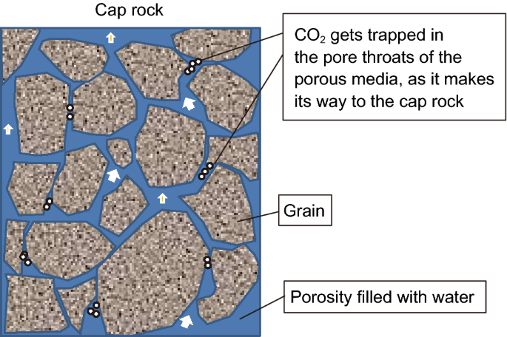
CCS POROSITY ACTIVITY
In the porosity activity, when water is added to jars containing sand and rocks, it infiltrates the microscopic gaps between the particles, displacing air and forming bubbles. The varying sizes and arrangements of these materials affect the water's permeability. Materials with larger or more numerous gaps allow more water to pass through, resulting in a lower water level in the jar. Conversely, materials with fewer or smaller gaps retain more water at the top, indicating lower porosity. Thus, the jar with the lowest water level contains the most porous material, while the jar with the highest water level contains the least porous material.
Porosity refers to the tiny holes within rocks that determine how much water, gas, or oil they can hold, crucial for underground CO₂ storage. Oil and gas formed from ancient sea creatures and plants, buried under sediment and transformed by heat and pressure into porous sedimentary rocks. These rocks, which store oil and gas in their pores, are capped by impermeable rock layers, making them ideal for CO₂ storage. CO₂ is injected into these spaces, left by extracted oil and gas or saline aquifers, after being liquefied to prevent leaks. Scientists are testing CO₂ storage in old reservoirs, like the Otway Basin in Australia.

Slide 9
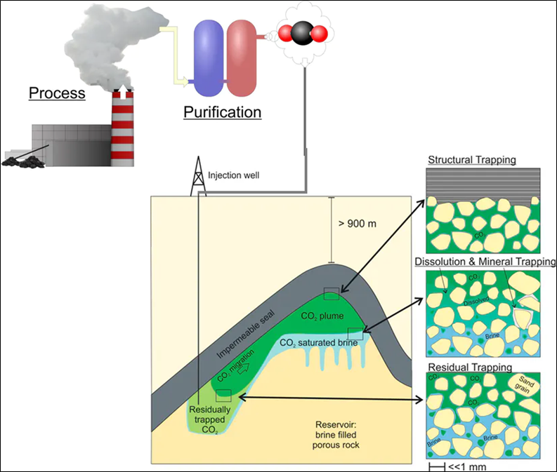
CARBON COMPRESSION ACTIVITY
The bottle filled with water models an underground oil and gas deposit, trapped under a rock cap like the bottle's lid. When gas is pumped in, it compresses the water, pushing it out through a straw, mimicking the pressurized system of an oil reservoir. The reaction between vinegar (acetic acid) and sodium bicarbonate produces CO₂ gas:
CH₃COOH + NaHCO₃ → NaCH₃COO + H₂CO₃
H₂CO₃ → H₂O + CO₂
These reactions show how gas is generated and displaced. Underground oil and gas are vital energy sources but burning them emits CO₂. To mitigate this, CO₂ can be captured at power stations and stored in depleted oil and gas reservoirs. These reservoirs, proven to securely contain natural gas for millions of years, are ideal for CO₂ storage. CO₂ is injected as a liquid due to high underground pressure, which can also enhance oil recovery by pushing out more oil, similar to how gas pushes water in the model. It can push out more of the oil in the reservoir like our gas pushed out the water, which is called Enhanced Oil Recovery EOR

Slide 10
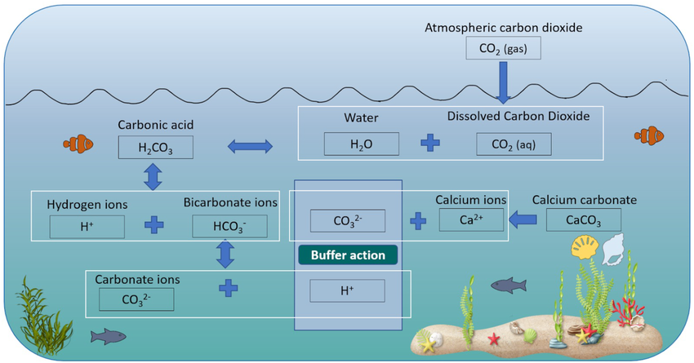
OCEAN ACIDIFICATION ACTIVITY
Indicators change colour in response to acids and bases, with red cabbage turning green in bases and red in acids, while bromothymol blue and phenol red change colours based on pH levels. In the experiment, CO₂ produced from vinegar (acetic acid) and sodium bicarbonate creates carbonic acid when bubbled through water, causing the indicator to shift colour. The key reactions are:
CH₃COOH + NaHCO₃ → NaCH₃COO + H₂CO₃
Acetic acid + sodium bicarbonate -> sodium acetate + carbonic acid
Then the carbonic acid breaks down:
H₂CO₃ → H₂O + CO₂
Carbonic acid -> Water + Carbon dioxide
When the CO2 goes through the straw and bubbles up through the water, it reverses the second reaction and produces some carbonic acid again.
H₂O + CO₂ → H₂CO₃
Water + Carbon dioxide -> Carbonic acid
This carbonic acid changes the colour of the indicator, eventually it will turn the whole solution acidic.

Slide 11
THANK YOU

